Slide 1
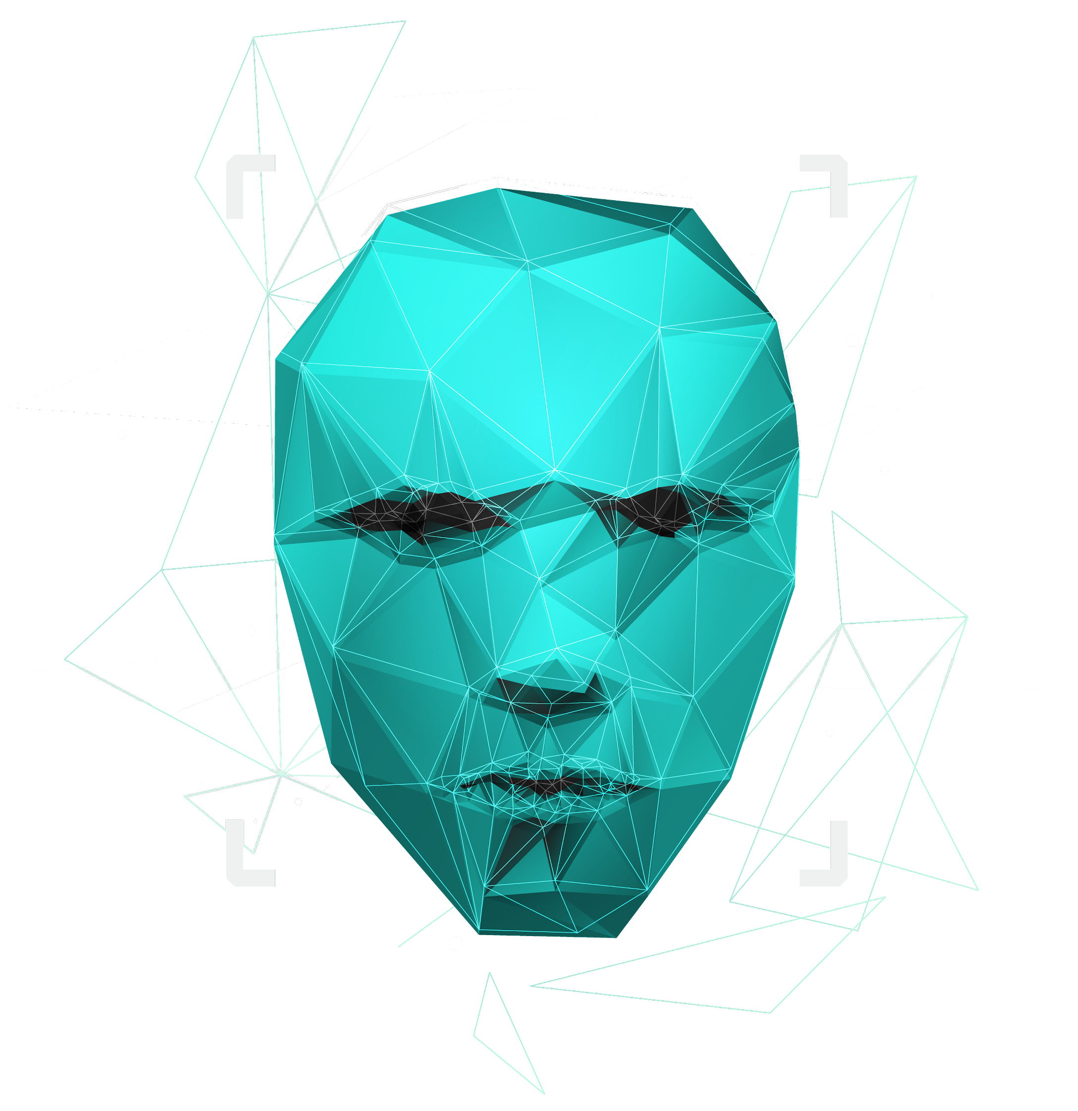
Loan Default Prediction
11 – Poonam Choudhary
24 – Jay Malde
32 – Jayadev Nair
40 – Ashish Sail

Slide 2
01
Problem Statement
02
EDA
03
Encoding
04
Imputation
CONTENTS
05
Balancing Dataset
06
Building Models
07
PCA
08
Performance Measure

Slide 3
Problem Statement
This case study aims to identify patterns which indicate if a client has difficulty paying their installments which may be used for taking actions such as denying the loan, reducing the amount of loan, lending (to risky applicants) at a higher interest rate, etc. This will ensure that the consumers capable of repaying the loan are not rejected. Identification of such applicants using EDA is the aim of this case study. In other words, the company wants to understand the driving factors (or driver variables) behind loan default, i.e. the variables which are strong indicators of default. The company can utilise this knowledge for its portfolio and risk assessment.

Slide 4
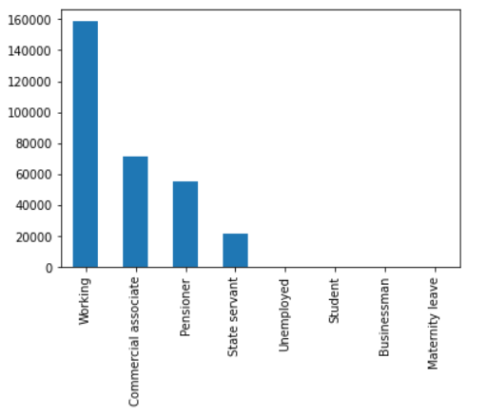
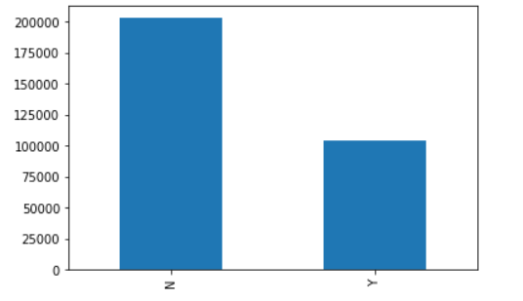
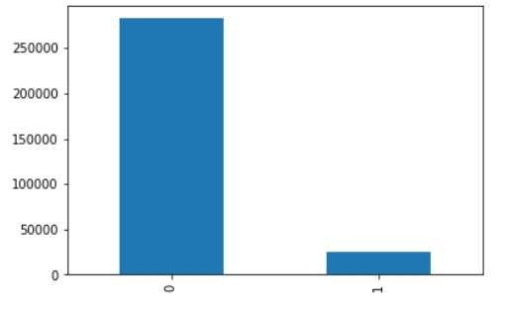
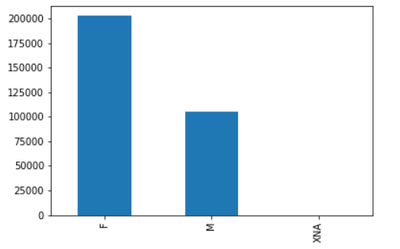
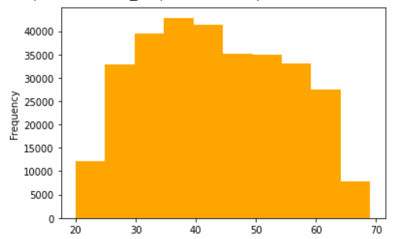
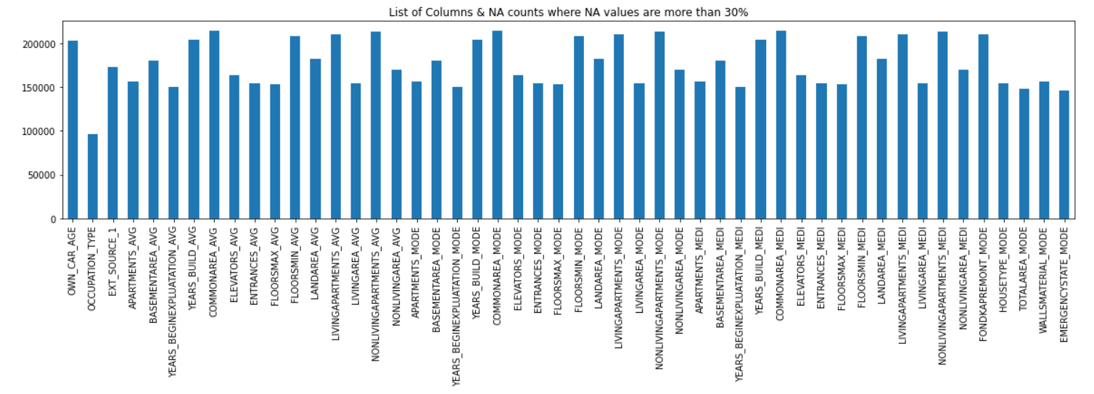
EDA

Slide 5
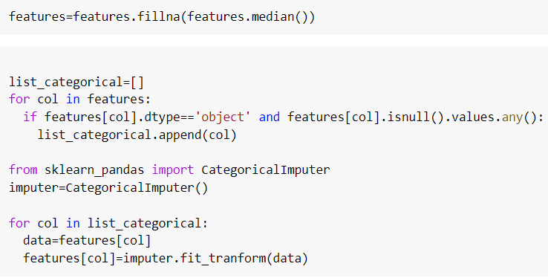
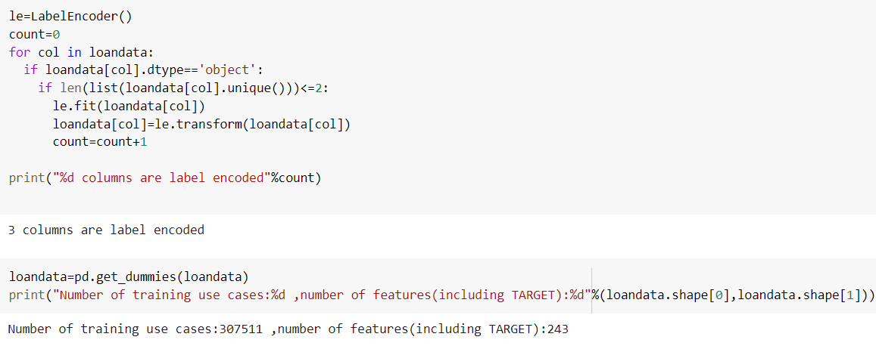
Encoding
Imputation

Slide 6
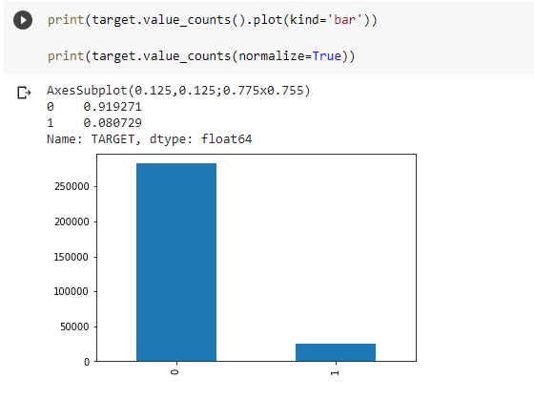
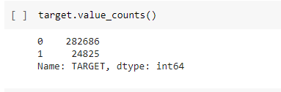
Balancing Target Column
Balancing Dataset

Slide 7

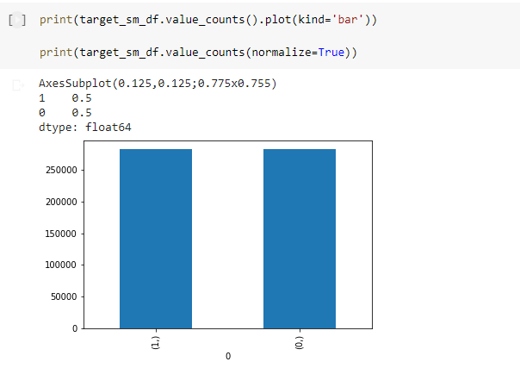
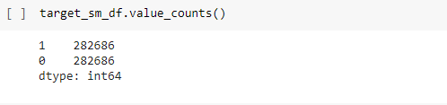
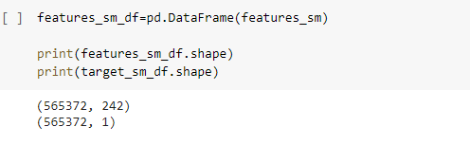
Balancing Target Column using SMOTE (Synthetic Minority Oversampling Technique)

Slide 8
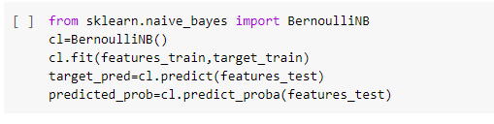
Naive-Bayes Bernoulli-With Balanced Data
Basic ML Model
Performance Measure
Accuracy | 83.78%
Sensitivity | 81.77%
specificity | 85.78%
AUC Score | 83.77%

Slide 9

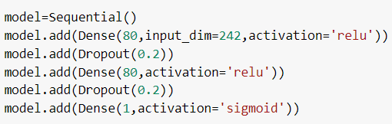
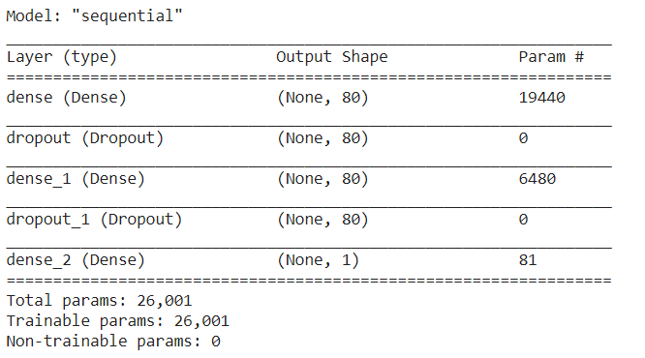
Input : 242 Features
Hidden : 80 Weights
Output : 1
Deep Learning Model 1
Loss : binary crossentropy
Activation : sigmoid
Optimizer : Adam
Epoch : 25

Slide 10

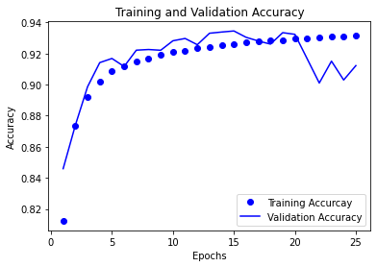
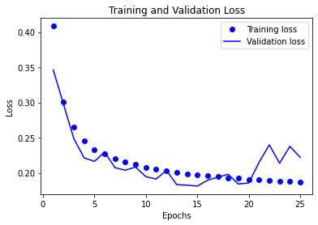
Epoch wise Comparison
Training & Validation Accuracy
Training & Validation Loss

Slide 11
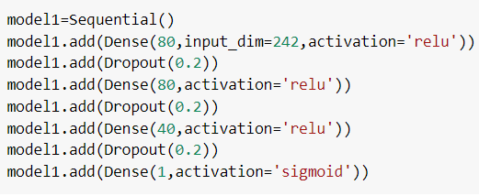
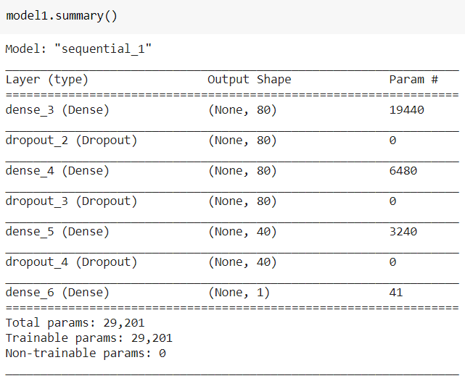
Input : 242 Features
Hidden : 80 Weights
Hidden : 40 Weights Output : 1
Deep learning Model 2
Loss : binary crossentropy
Activation : sigmoid
Optimizer : Adam
Epoch : 15

Slide 12
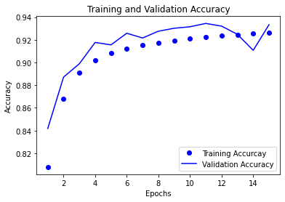
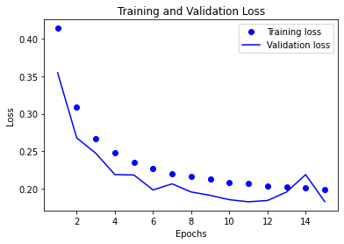
Epoch wise Comparison
Training & Validation Accuracy
Training & Validation Loss

Slide 13
Performance Measures on Model with 3 Layers
Metrics | Score
Accuracy Score | 0.9122
Sensitivity | 0.9217
Specificity | 0.9027
ROC_AUC_Score | 0.8385
Performance Measures on Model with 4 Layers
Metrics | Score
Accuracy Score | 0.9333
Sensitivity | 0.9058
Specificity | 0.9606
ROC_AUC_Score | 0.8385

Slide 14
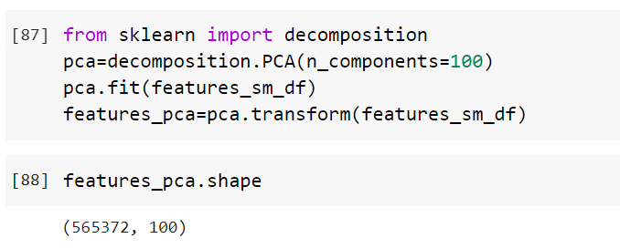
Principal Component Analysis

Slide 15
Performance Measures
Accuracy | Before PCA | After PCA
Baseline model | 83% | 67%
DL model with 4 Layers | 90% | 65%
DL model with 5 layers | 93% | 65%
DL model with 4 layers | Before PCA | After PCA
Sensitivity | 92% | 46%
Specificity | 89% | 84%
AUC | 83% | 83%
DL model with 5 layers | Before PCA | After PCA
Sensitivity | 89% | 38%
Specificity | 97% | 91%
AUC | 83% | 83%

